Slide 1
IoT
Jinesh K J
Manager I & E Cell
JECC
jineshkjose@gmail.com
9400086378
github.com/jineshkjose

Slide 2

What is an IoT
It’s a physical object that connects to the Internet. It can be a fitness tracker, a thermostat, a lock or appliance – even a light bulb.

Slide 3
IoT-embedded system
An IoT embedded system is an embedded system that has internet connectivity. Another word for what is IoT-embedded system is a "smart" device.
A touch screen and a keyboard are not necessary to define a device as an IoT embedded system, although these peripherals can also be attached

Slide 4
Node MCU
The NodeMCU (Node MicroController Unit) is an open-source software and hardware development environment built around an inexpensive System-on-a-Chip (SoC) called the ESP8266.

Slide 5
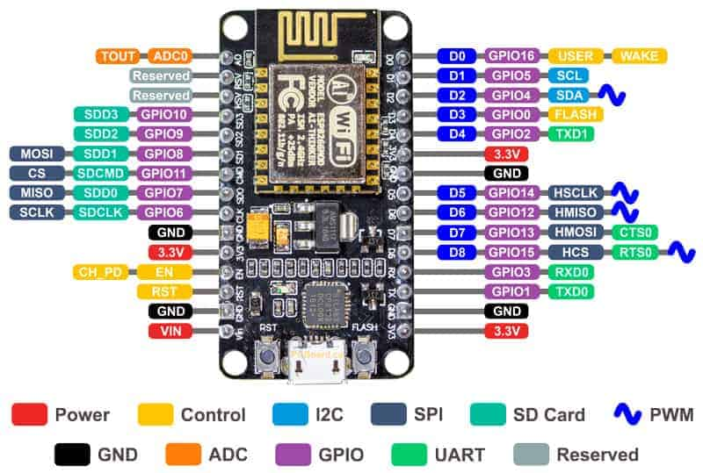

Slide 6
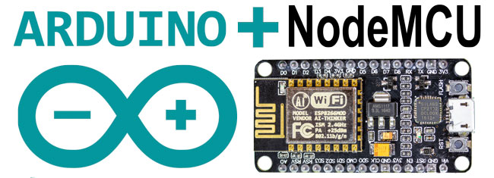

Slide 7

Arduino Basics
It's an open-source physical computing platform based on a simple microcontroller board, and a development environment for writing software for the board.

Slide 8
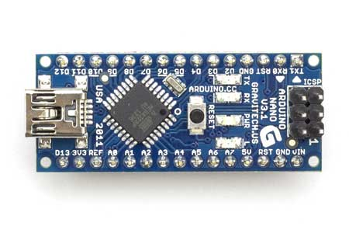
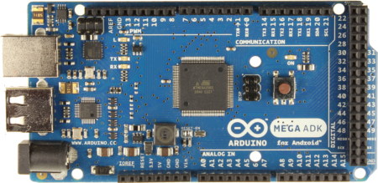
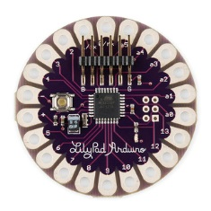
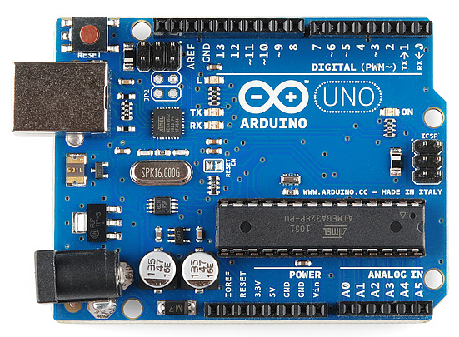
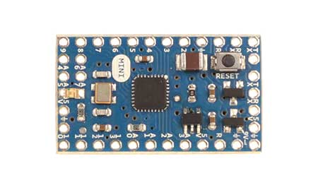
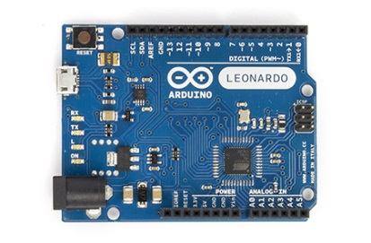
Types of Arduino Boards
Arduino Nano
Arduino Mega
Arduino LilyPad
Arduino Uno
Arduino Mini
Arduino Leonardo

Slide 9
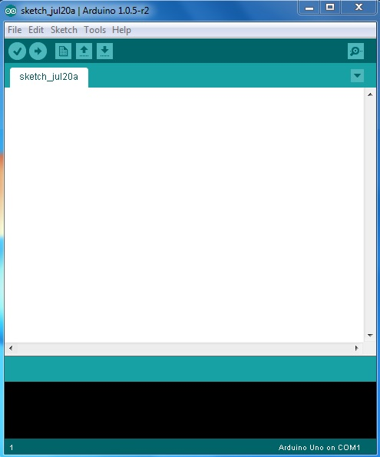
Arduino IDE
VERIFY
SERIAL MONITOR
UPLOAD
NEW TAB
OPEN
CODE GOES HERE
SAVE
BOARD & SERIAL PORT SELECTIONS

Slide 10
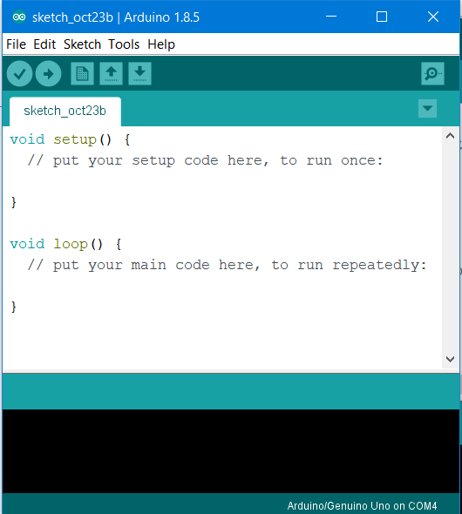
Basic Coding structure

Slide 11
Basic Coding structure
setup() function
Called when a sketch starts.
To initialize variables, pin modes, start using libraries, etc.
Will only run once, after each power-up or reset of the Arduino board.
loop() function
Loops consecutively.
Code in the loop() section of the sketch is used to actively control the Arduino board.
Commenting
Any line that starts with two slashes (//) will not be read by the compiler, so you can write anything you want after it.

Slide 12
pinMode()
Instruction used to set the mode (INPUT or OUTPUT) in which we are going to use a pin.
Eg: pinMode (13, OUTPUT);
ie. setting pin13 as output.
digitalWrite()
Write a HIGH or a LOW value to a digital pin.
Eg: digitalWrite (11, HIGH);
ie. setting pin 11 to high.

Slide 13
digitalRead()
Reads the value from a specified digital pin, either HIGH or LOW
Eg: int inPin=7;
val = digitalRead(inPin);
ie. reads the value from inPin and assigns it to val.
delay()
Pauses the program for the amount of time (in milliseconds) specified as parameter.
Eg: delay(1000);
ie. waits for a second (1000 ms = 1 s)

Slide 14
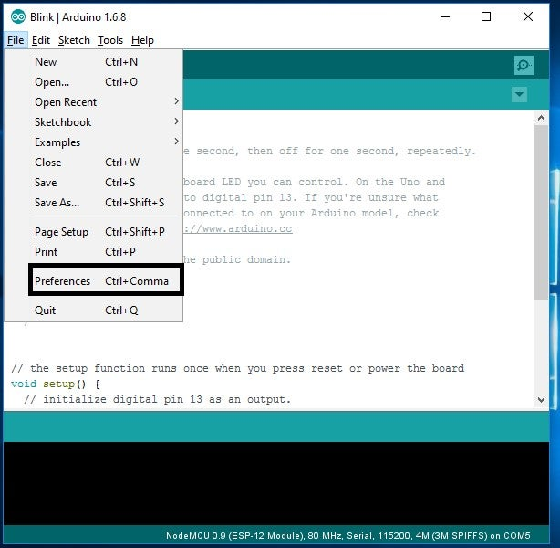
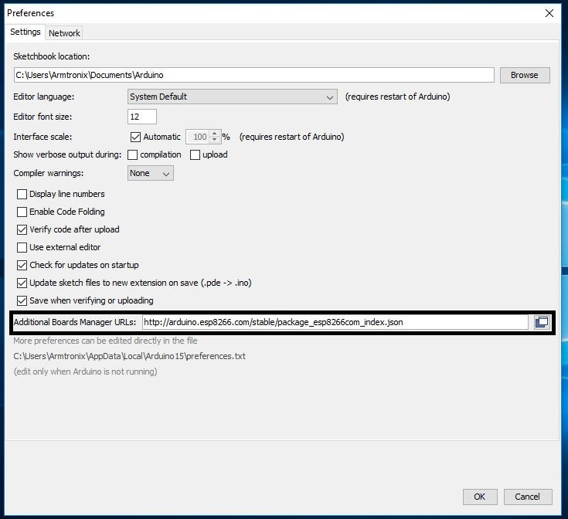
Setting up Arduino IDE for NodeMCU
In the Additional Boards Manager enter below URL.
http://arduino.esp8266.com/stable/package_esp8266com_index.json

Slide 15
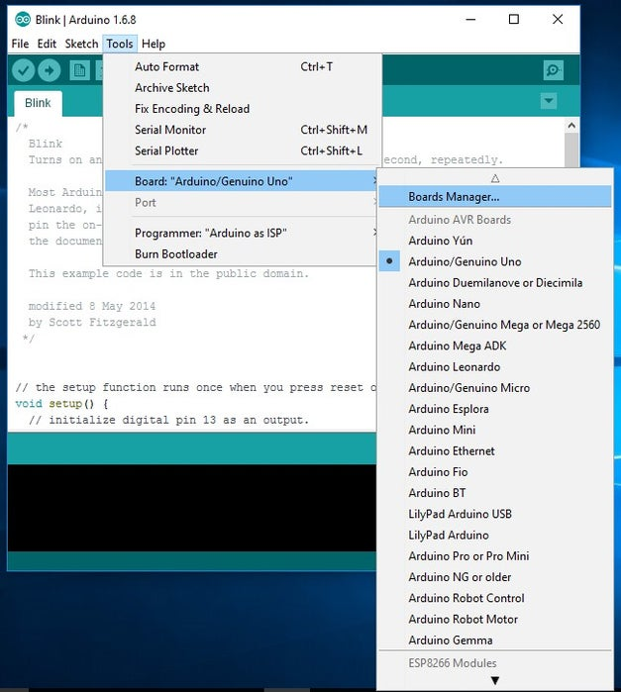
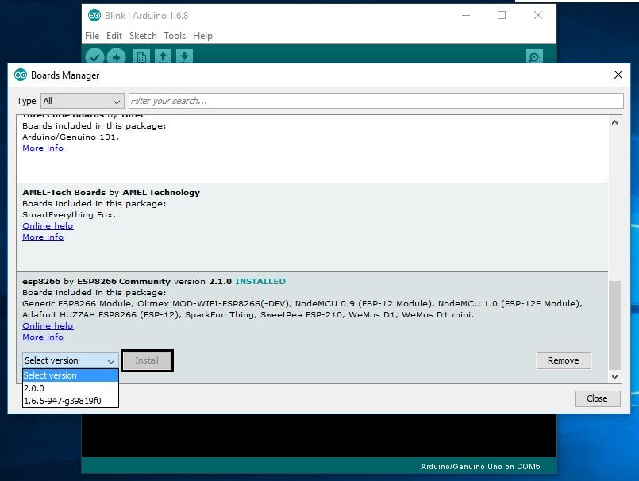

Slide 16
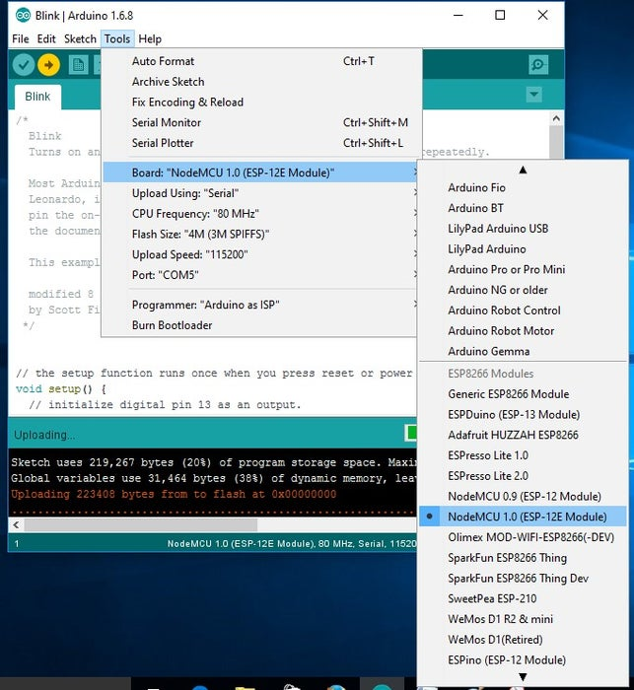
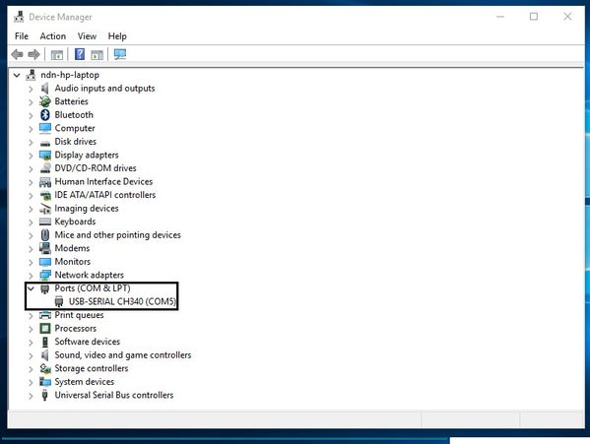

Slide 17
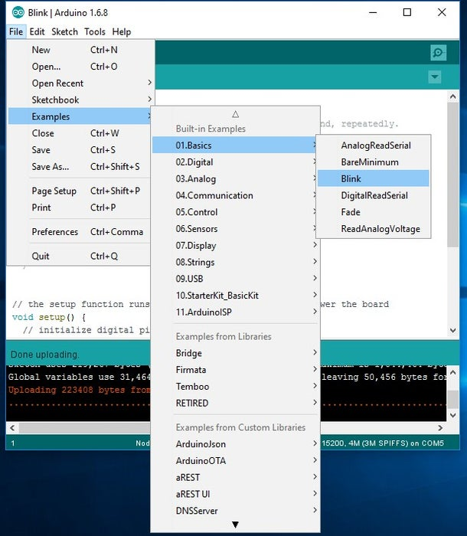

Slide 18
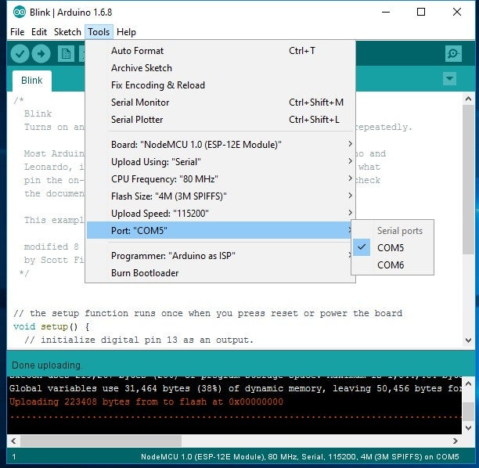

Slide 19
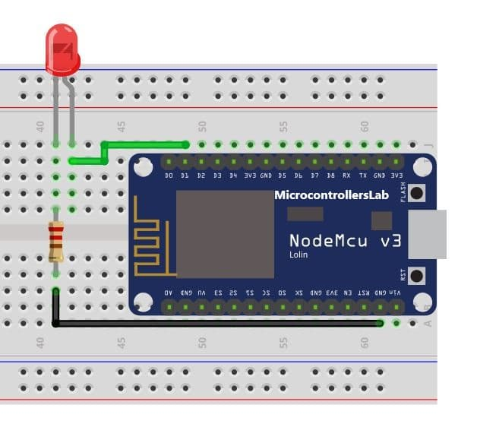

Slide 20
void setup() {
// initialize digital pin LED_BUILTIN as an output.
pinMode(D1, OUTPUT);
}
// the loop function runs over and over again forever
void loop() {
digitalWrite(D1, HIGH); // turn the LED on (HIGH is the voltage level)
delay(1000); // wait for a second
digitalWrite(D1, LOW); // turn the LED off by making the voltage LOW
delay(1000); // wait for a second
}

Slide 21
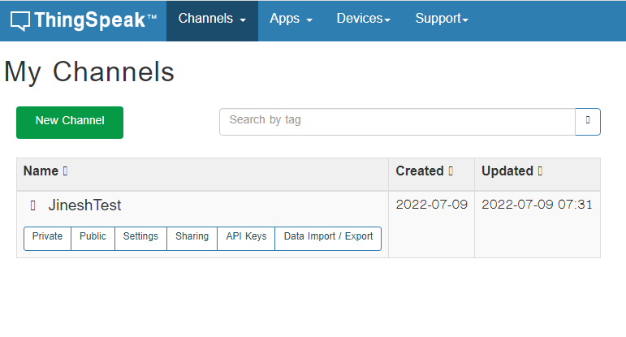
LED Control via Thingspeak
Step1: Setting ThingsSpeak
First login to the Thingspeak server. https://thingspeak.com/login
If you are new user then create the new account.
Click on the New Channel.

Slide 22
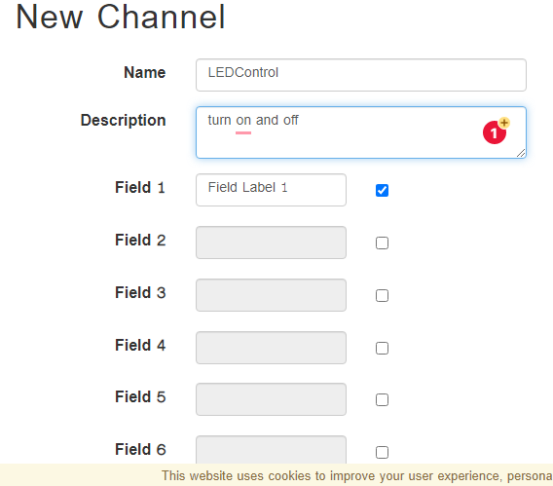
After click the new channel and first write the name of the new channel .
if you want give the description then write the description. and select the Field 1 and don't forget the click on checkbox, after click on the check box scroll the page and click on the save button.

Slide 23
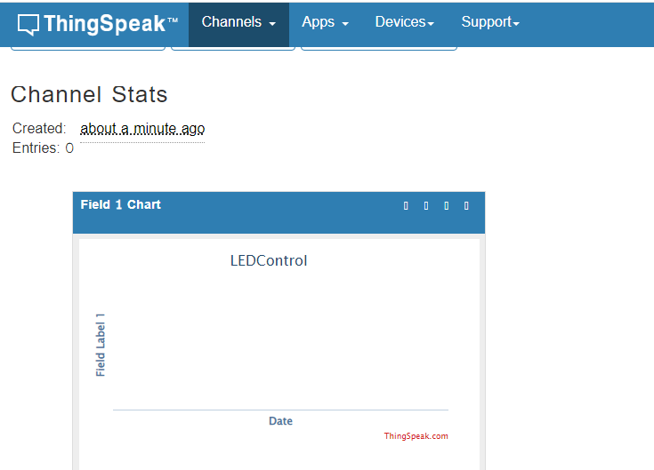
Now show your field 1 as a charts.

Slide 24
To set up Arduino IDE to use NodeMCU 1.0, follow these steps:
Download and install the Arduino IDE from the official Arduino website.
Open the Arduino IDE and go to File > Preferences. In the “Additional Boards Manager URLs” field, add the following URL:
http://arduino.esp8266.com/stable/package_esp8266com_index.json
Go to Tools > Board > Boards Manager. In the Boards Manager window, search for “esp8266” and install the “esp8266” board package.
Once the installation is complete, go to Tools > Board and select “NodeMCU 1.0 (ESP-12E Module)”.
Connect your NodeMCU board to your computer via a USB cable. In the Arduino IDE, go to Tools > Port and select the port your NodeMCU board is connected to.
You’re now ready to start programming your NodeMCU board using the Arduino IDE. You can write your code, compile it, and upload it to your board just like you would with any other Arduino board.
Note: If you encounter any errors while uploading the code to your NodeMCU board, try pressing and holding the “flash” button on the board while uploading the code. This will put the board into flash mode and allow the code to be uploaded.

Slide 25
https://www.electronicwings.com/users/shravanprajapati122/projects/228/led-control-via-thingspeak-server-using-nodemcu-esp8266

